Slide 1
Networking

Slide 2
TOPIC
INTRODUCTION TO NETWORKS
TYPE OF AREA NETWORKS – LAN, VLAN, CAN, MAN, WAN
INTERNET AND INTRANET

Slide 3
INTRODUCTION TO NETWORKS
What is computer network?
A group of computers which are connected to each other for the purpose of sharing their resources is called computer network.
First computer network is ARPANET (Advanced Research Project Agency Network).
Two or other devices or nodes are connected to each other and established a connection. It is called as networking.

Slide 4
Characteristics of a network
Share resources from one computer to another.
Backup
Communication Speed
Scalability
Reliability
Software And Hardware Sharing
Security

Slide 5
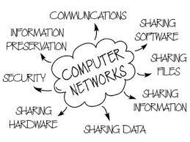
Advantages Of Computer Networks
Open to everyone
File sharing
Security
Easy to add new devices
Backup and storage
Communication

Slide 6
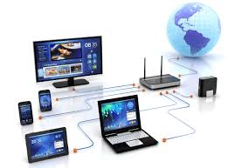
Disadvantages Of Computer Networks
Network device required
Virus attack
Required handler
High speed internet
Server

Slide 7
Types of area networks
LAN (Local area network)
Man (metropolitan area network)
Wan (wide area network)
Vlan (virtual local area network)
Wlan (wireless local area network)
Can (campus area network)
ETC.

Slide 8
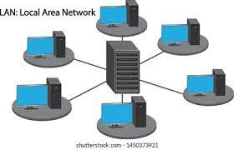
LAN (Local area network)
Group of interconnected computers within a small area. (room, building, campus).
Transmission speed of data is high.
Lan network range 0 to 150m.
Lan network ownership is private.
Lan network error rate and setup cost is low.

Slide 9
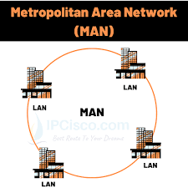
man (metropolitan area network)
A MAN is basically a bigger version of a LAN and normally uses similar technology.
Transmission speed of data is average.
Man network range 5 to 50km.
Man network ownership is private or public.
Man network error rate and setup cost is average.

Slide 10
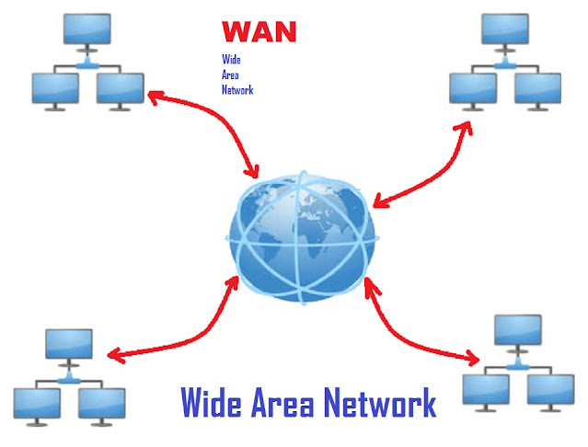
wan (wide area network)
A Wide area network is a network that extends over a large geographical area such as states or countries.
Transmission speed of data is low.
Wan network range is not fixed.
Wan network ownership also private or public.
Wan network error rate and setup cost is very high.

Slide 11
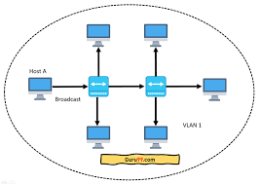
VLAN (VIRTUAL LOCAL AREA NETWORK)
Virtual Local Area Networks (Vlans) divide a single existing physical network into multiple logical networks.
Thereby, each Vlan forms its own broadcast domain.
Communication between two different Vlans is only possible through a router that has been connected to both Vlans.

Slide 12
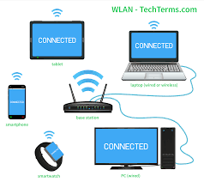
Wlan (wireless local area network)
A WLAN makes use of a wireless access point (WAP) device, which serves as the point of connectivity for wireless clients on the network.
A LAN that uses high frequency radio waves for communication.
Provides short range connectivity with high speed data transmission

Slide 13
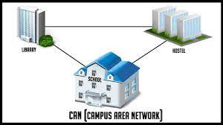
Can (campus area network)
A Campus Area Network (CAN) is a network of multiple interconnected local area networks (LAN) in a limited geographical area.
CAN is smaller than wan (wide area network).
CAN is also known as a controller area network.

Slide 14

INTERNET AND INTRANET
What is Internet?
It is a global network of computers, to exchange information.
It is a “networks of networks” that includes millions of private and public, academic, business and government networks (local or global), linked by copper wires, wireless connections and other technologies.

Slide 15
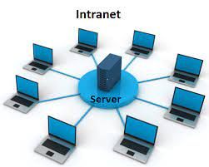
Internet and intranet
WHAT IS INTRANET?
Internet company network that uses internet standards (HTML, HTTP & TCP/ IP protocols) & software.
Accessed only by authorized persons, especially members or employees of the organization.

Slide 16
DIFFERENCE BETWEEN INTERNET AND INTRANET
INTERNET
Internet is a public network.
Any one can access the internet.
Unlimited users.
Internet is less secure.
Internet is a huge network consisting of lan, man and wan.
There is no owner of internet.
INTRANET
Intranet is a private network.
Only members of university, company can access intranet.
Limited users.
Intranet is completely secure.
But intranet is mostly dependent on lan.
Intranet has some owner.

Slide 17
THANK YOU!!

